Slide 1

NETFLIX DATA ANALYSIS PROJECT
AREEB SAJID
INTERNSHIP_17546440516895be537820f

Slide 2

PROBLEM STATEMENT
Netflix has become one of the most prominent global streaming platforms, continuously expanding its library with a mix of original productions and licensed content. However, with growing competition from platforms like Amazon Prime, Disney+, and regional OTT providers, Netflix must strategically analyze its content catalog to identify strengths, gaps, and opportunities.
The specific problem to be addressed in this project is 'Content Trends Analysis for Strategic Recommendations'. The aim is to uncover how Netflix’s content distribution (Movies vs. TV Shows, genres, and country contributions) has evolved over the years. This will enable the identification of key genres, audience preferences, and strategic insights into global content expansion.

Slide 3
PROJECT DESCRIPTION
The dataset under consideration is a Netflix dataset containing 7,789 records and 11 columns. It includes important details about Movies and TV Shows available on the platform. Key attributes include the title, director, cast, country of origin, release date, rating, duration, and type (genres). The dataset spans multiple years, with entries ranging from 2008 to 2021, covering content across diverse countries and genres.
Understanding Netflix’s content trends is crucial for making data-driven business decisions. The analysis not only highlights the balance between Movies and TV Shows but also reveals popular genres and underrepresented categories. For a platform that serves diverse international audiences, country-wise contributions provide valuable insights into global representation and market penetration.
By focusing on these content trends, Netflix can refine its strategy for content acquisition and production, ensuring that it caters to the right audience segments while staying competitive in the global OTT industry.

Slide 4

Technology Used
Python – Core programming language
Pandas & NumPy – Data cleaning and preprocessing
Scikit-learn – Machine learning (model training, regression, evaluation)
Matplotlib/Seaborn– Data visualization and feature importance
Google Colab – Cloud-based environment for running the project
File handling libraries – openpyxl (for Excel) and built-in CSV handling

Slide 5
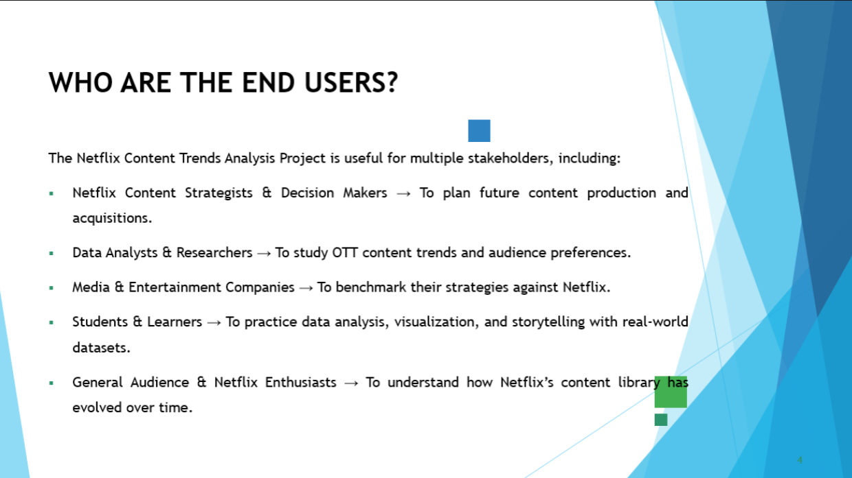

Slide 6
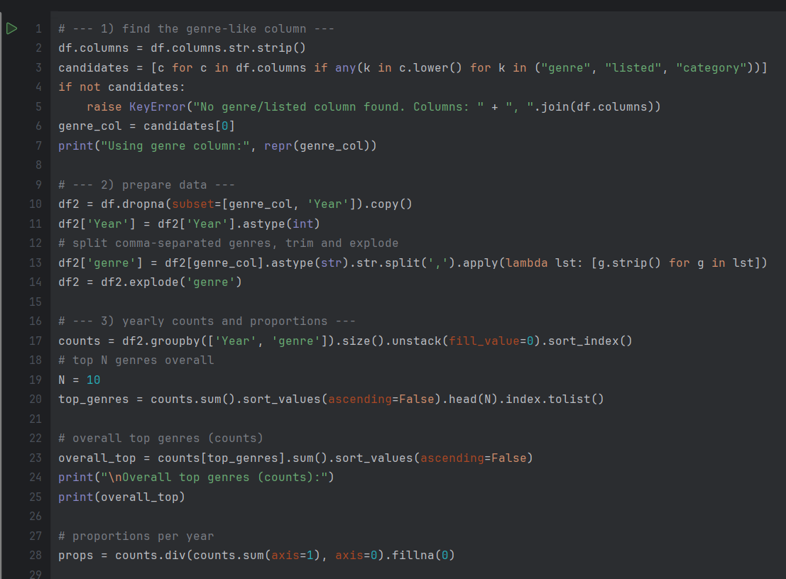
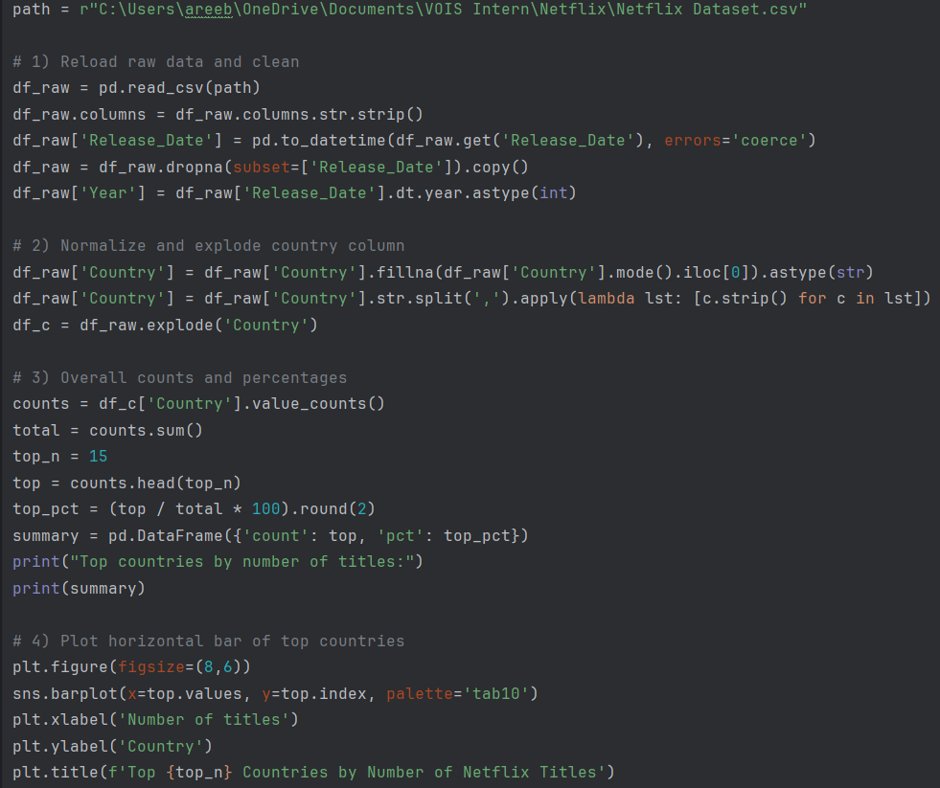
PYTHON CODE

Slide 7
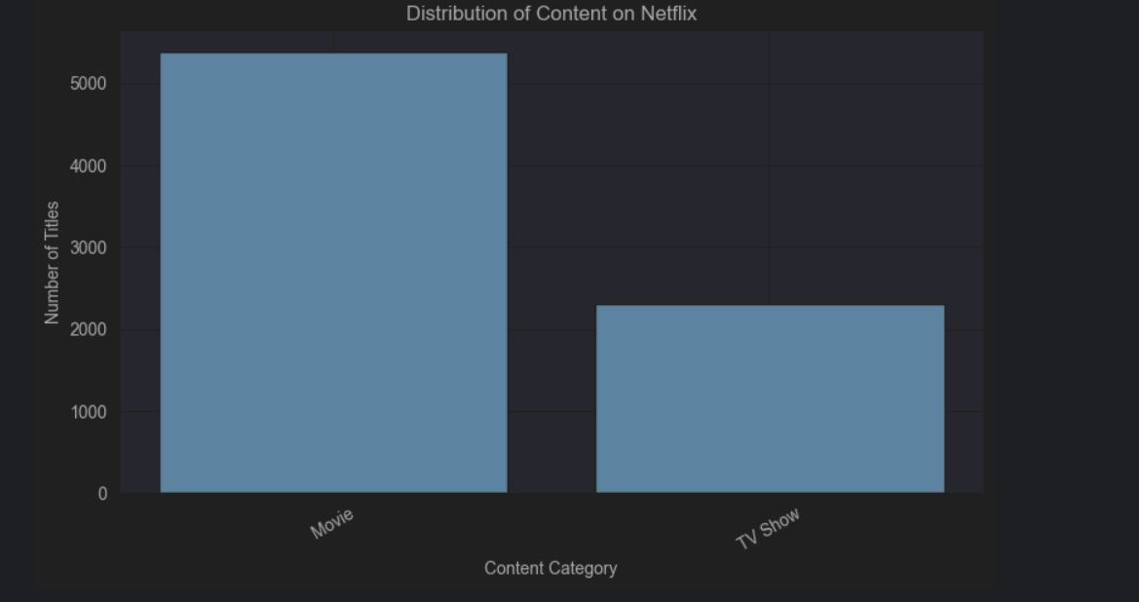
RESULTS1
[Add screen shots of your code or Chart(s) ]

Slide 8
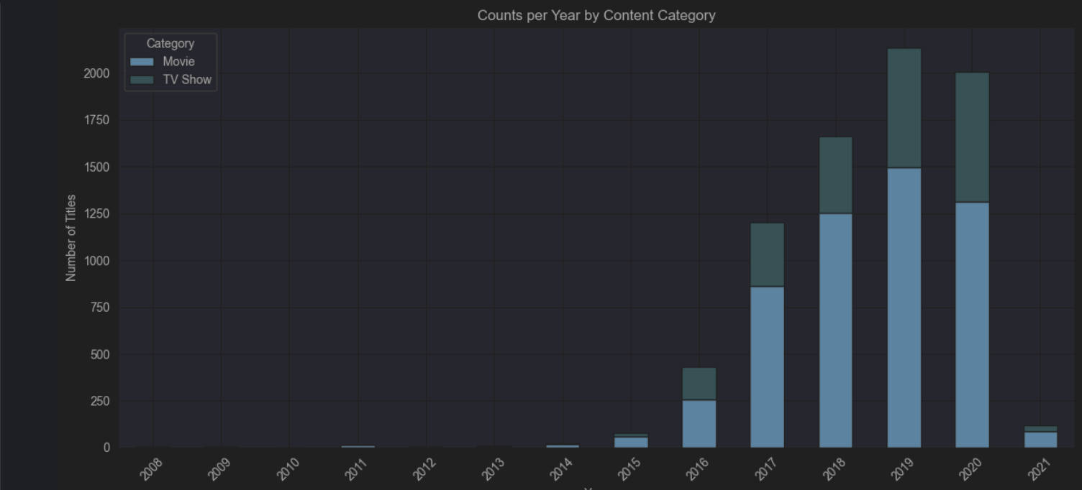
RESULTS2
[Add screen shots of your code or Chart(s) ]

Slide 9
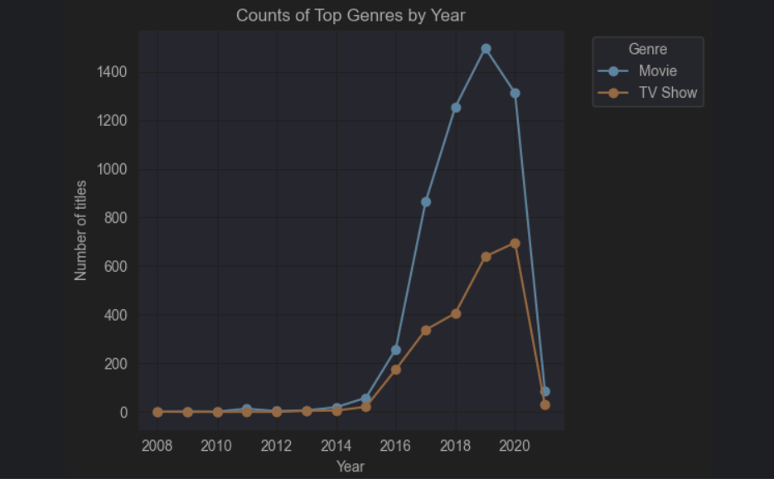
RESULTS3
[Add screen shots of your code or Chart(s) ]

Slide 10
GitHub repository
git@github.com:Areeb1471/VOIS_AICTE_Oct2025_MajorProject_AreebSajid.git

Slide 11

Getting started with Basics of Python Certificate
[Paste your Certificate Here]

Slide 12
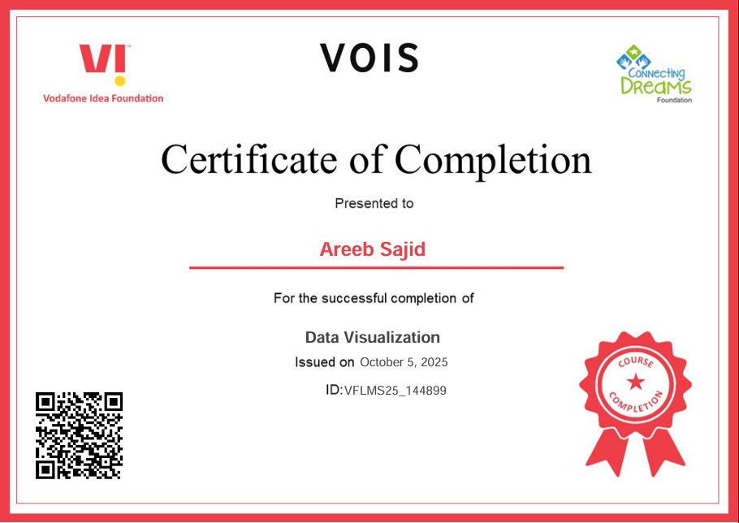
Data Visualization Certificate
[Paste your Certificate Here]

Slide 13
Thank you
.
.

